Slide 1
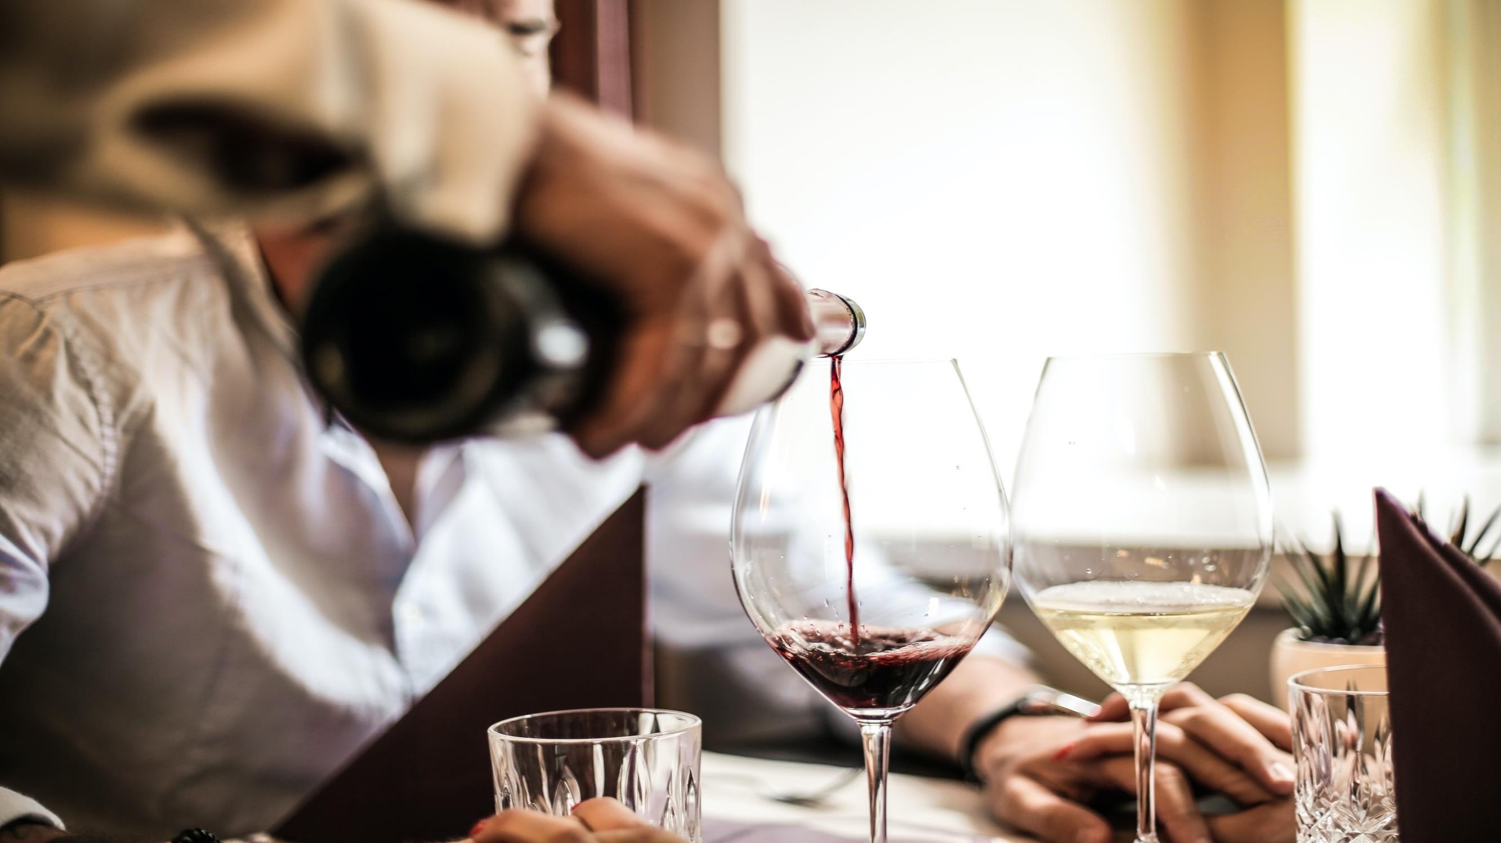

WINE QUALITY
PREDICTION
USING MACHINE LEARNING
Presented By:
Amulya Walimbe Sakshi Singh Nisha Sagar
Saras Shirgaonkar
CEC546 CEC536 CEC531 CEC532

Slide 2
Objective
Problem Definition
System Requirements:
Hardware Requirements
Software Requirements

Slide 3
Introduction
Project deals with prediction of quality of wine using various parameters.
Dataset is taken from Kaggle.
Model is trained and evaluated to give a final result.

Slide 4
Literature Review
The wine quality prediction proposed by Rohan Kothawade (2021) is based on how to speed up the process by reducing human wine testing method.
The wine quality prediction proposed by Mohit Gupta et al (May 2021), testing is done by automates software that uses Data Mining which is based on mathematical algorithm required to drive the preferred results from the enormous collection of databases.
The wine quality prediction proposed by Dr. T. Narashimha Rao(2022) is based on several features, results of past systems and existing systems were compared to increase accuracy.

Slide 5
Methodology
Definition of Random Forest Classifier.
Supervised learning technique.
Based on the concept of ensemble learning.

Slide 6
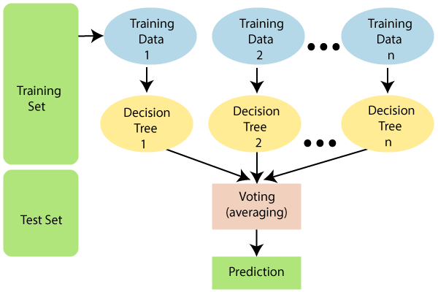
Algorithm
Working is divided into two-phases.
There are three steps involved in the working of this classifier.

Slide 7
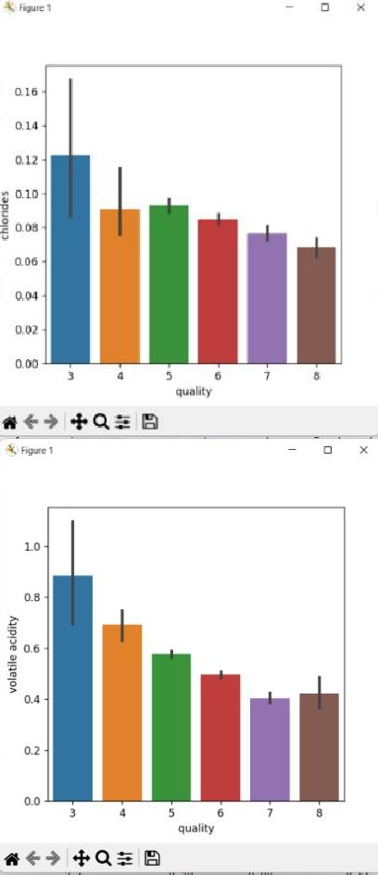
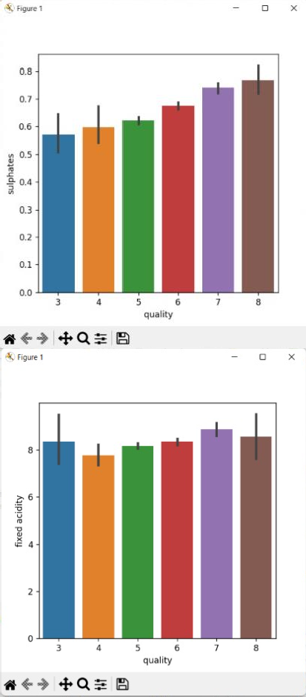
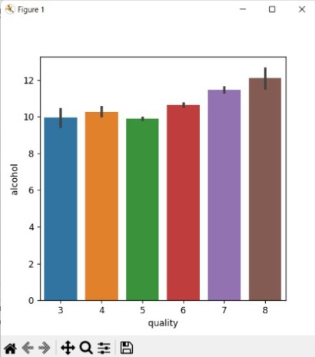
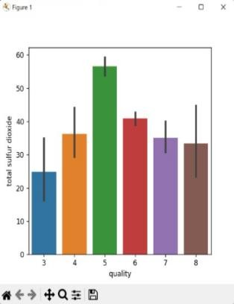
Bar- Plot Analysis

Slide 8
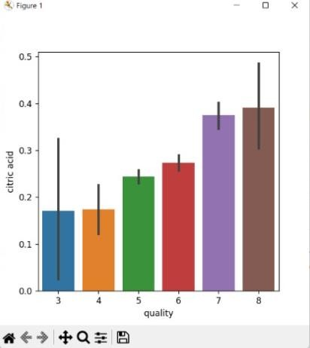
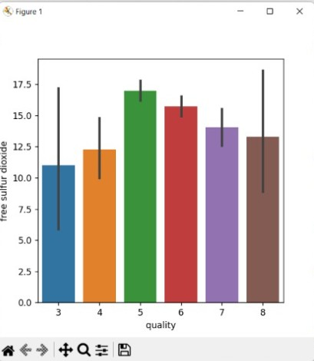
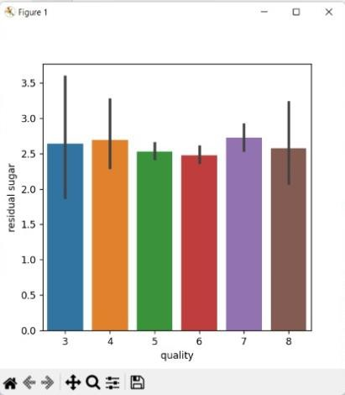
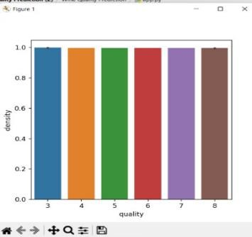
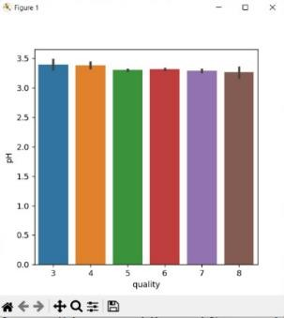
Bar- Plot Analysis

Slide 9
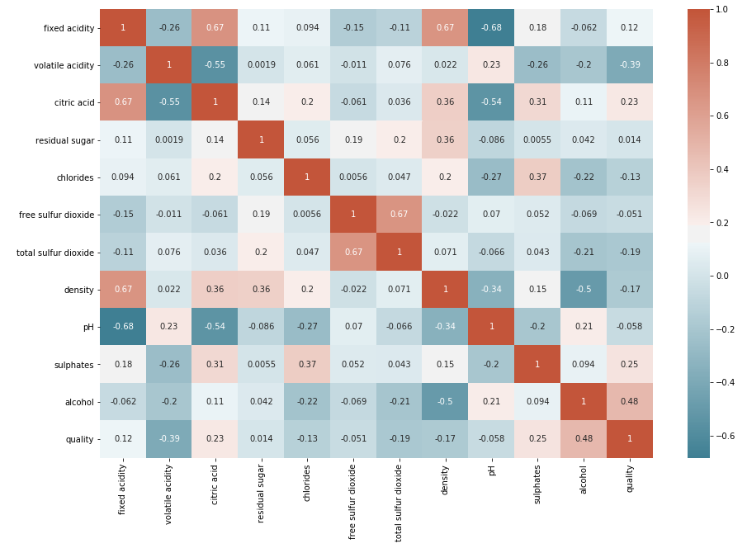
Heat- Map Analysis

Slide 10
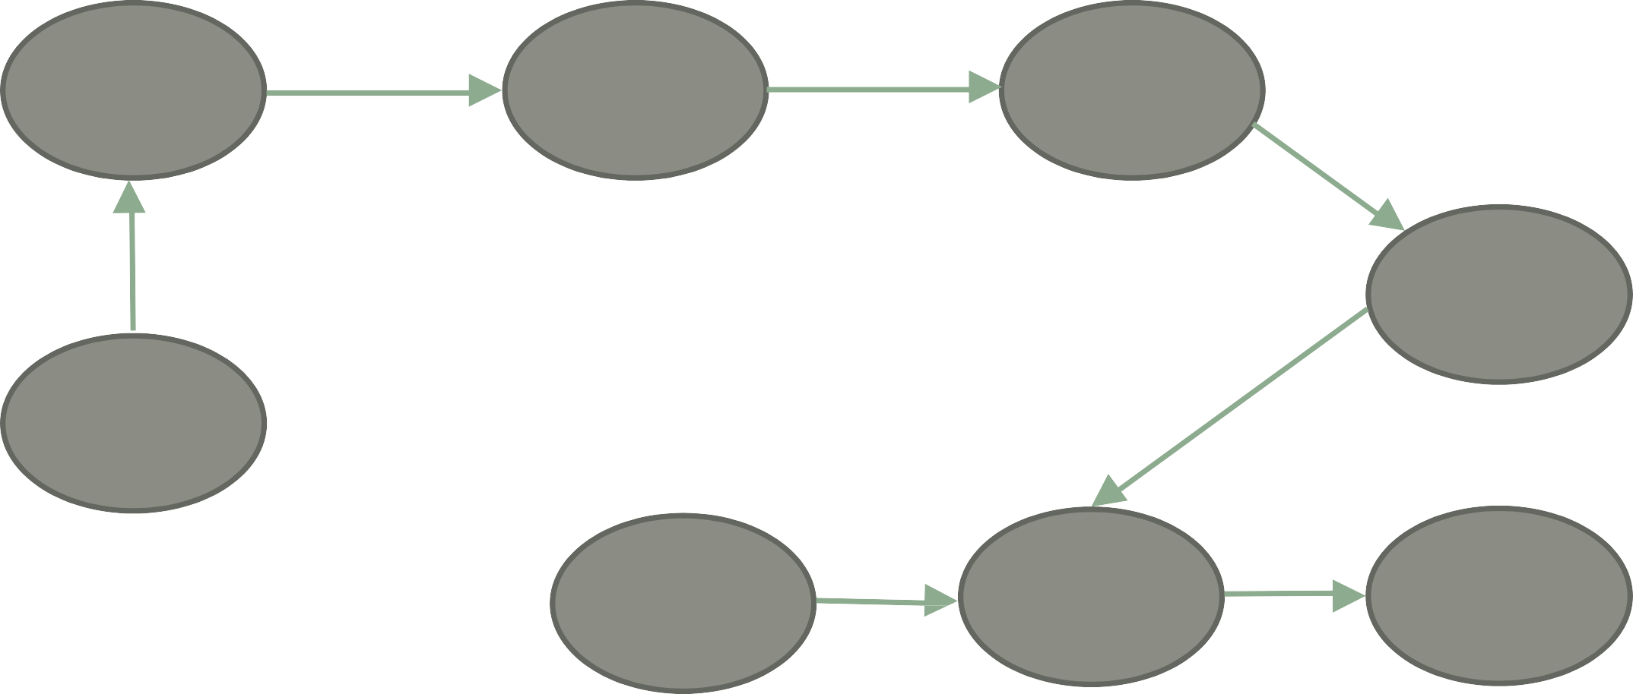
System Overview
Data Pre- processing
Train-Test Split
Data Analysis
Model
Training
Data Collection
Input
Data
Trained
RFM
Output

Slide 11
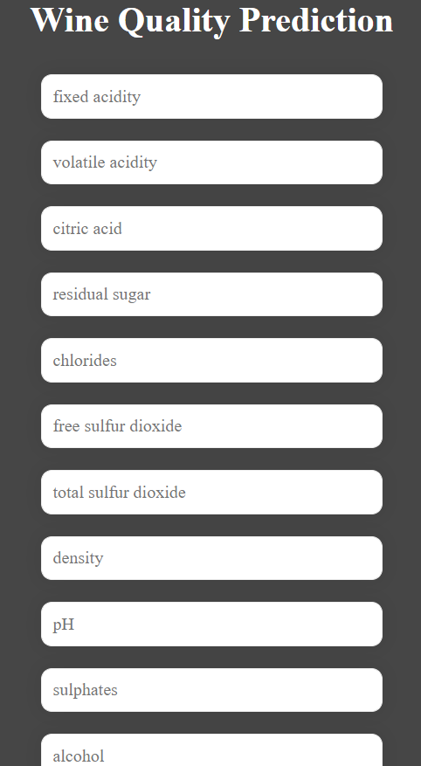
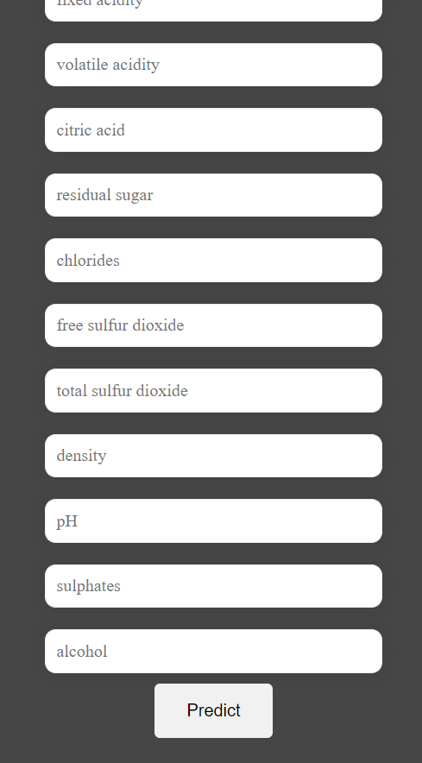
Implementation

Slide 12
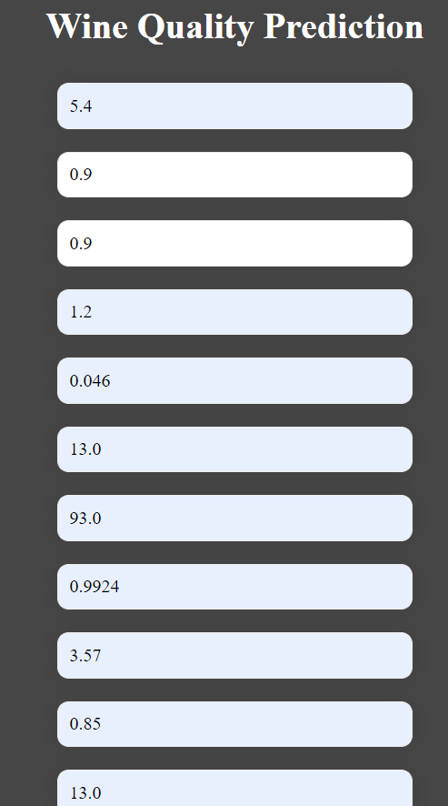
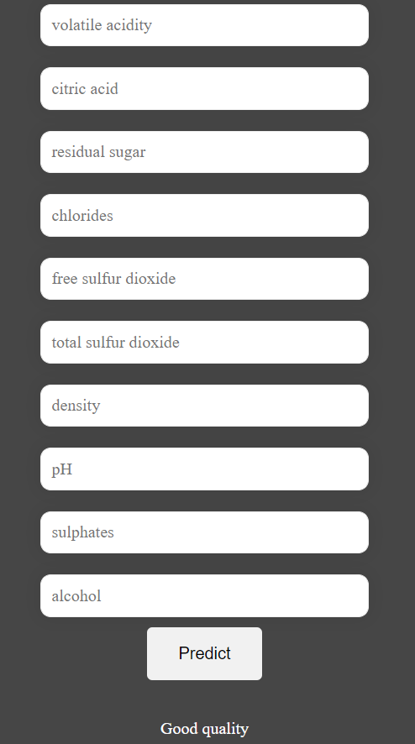
Implementation (Good Quality)

Slide 13
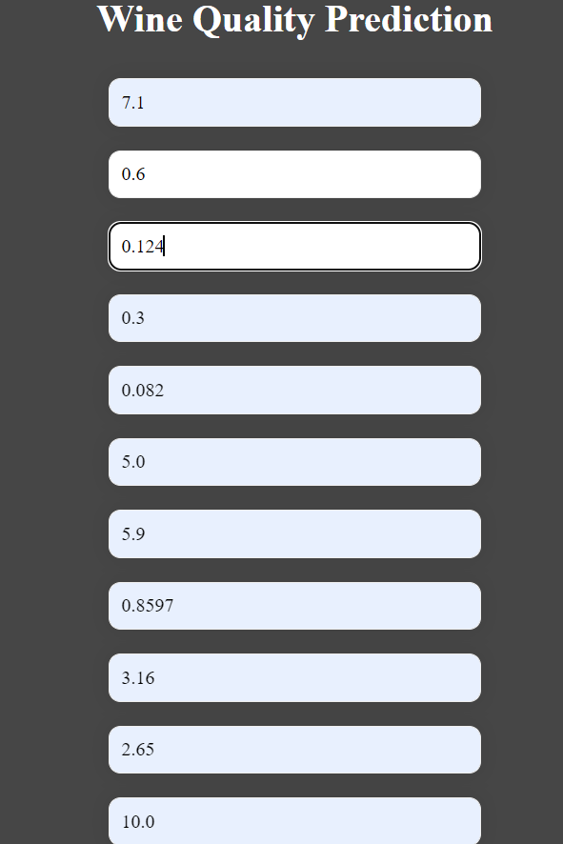
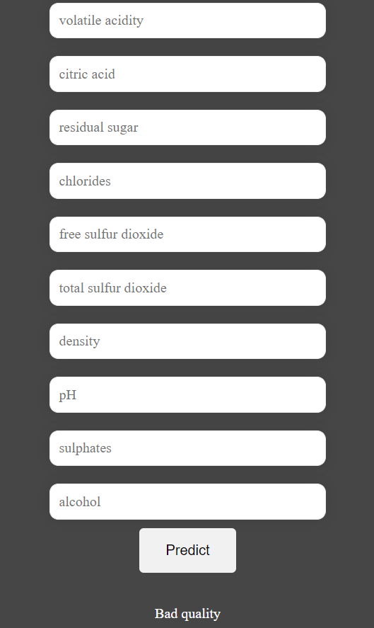
Implementation (Bad Quality)

Slide 14
Conclusion and Future Scope
Machine learning steps were implemented.
Accuracy is a key feature while selecting algorithm for the model.
Converting imbalanced data into balanced data is the main strategy.
Limitations and overcoming those limitations.
Using other machine learning models and evaluating the model accordingly.
Recommendations.

Slide 15
References
https://www.divaportal.org/smash/get/diva2:15 74730/FULLTEXT01.pdf
https://towardsdatascience.com/red-wine- quality-prediction-usingregression-modeling- and-machine-learning-7a3e2c3e1f46
http://junikhyatjournal.in/no_1_Online_22/72. pdf.

